Slide 2
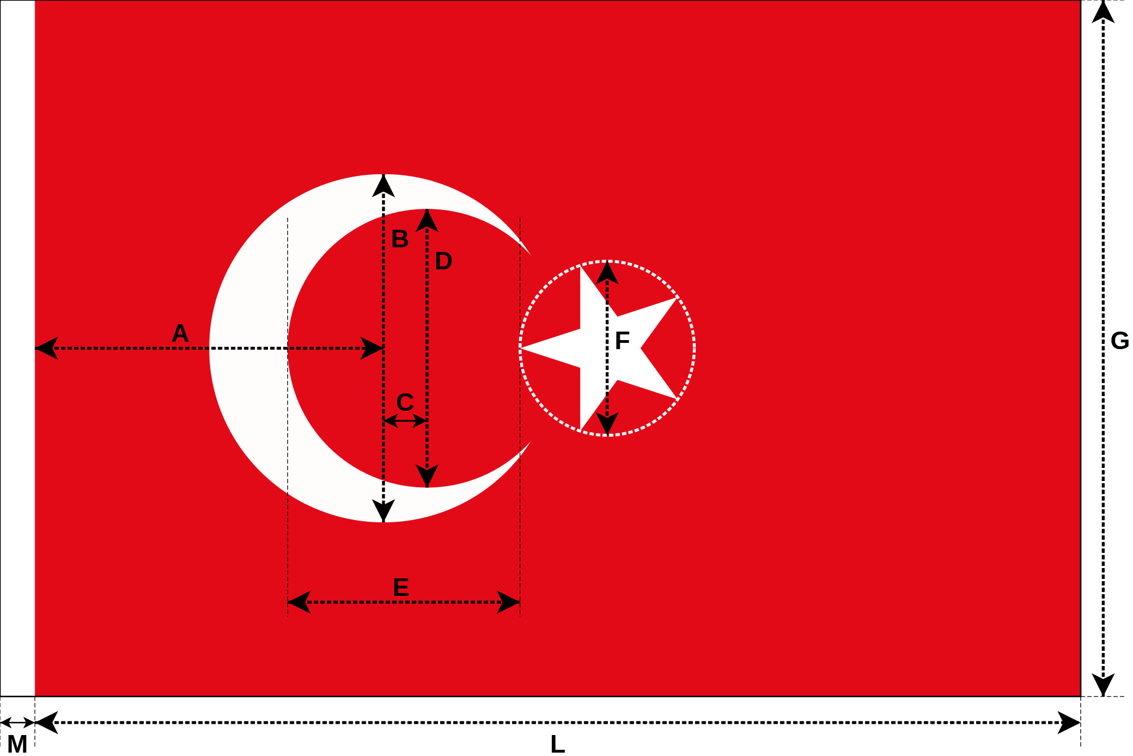
Letter | Measure | Length
G | Width
A | Distance between the centre of the outer crescent and the seam of the white band | ¹⁄₂ G
B | Diameter of the outer circle of the crescent | ¹⁄₂ G
C | Distance between the centres of the inner and outer circles of the crescent | ¹⁄₁₆ G
D | Diameter of the inner circle of the crescent | ²⁄₅ G
E | Distance between the inner circle of the crescent and the circle around the star | ¹⁄₃ G
F | diameter of the circle around the star | ¹⁄₄ G
L | Length | 1 ¹⁄₂ G
M | Width of the white hem at the hoist | ¹⁄₃₀ L

Slide 3
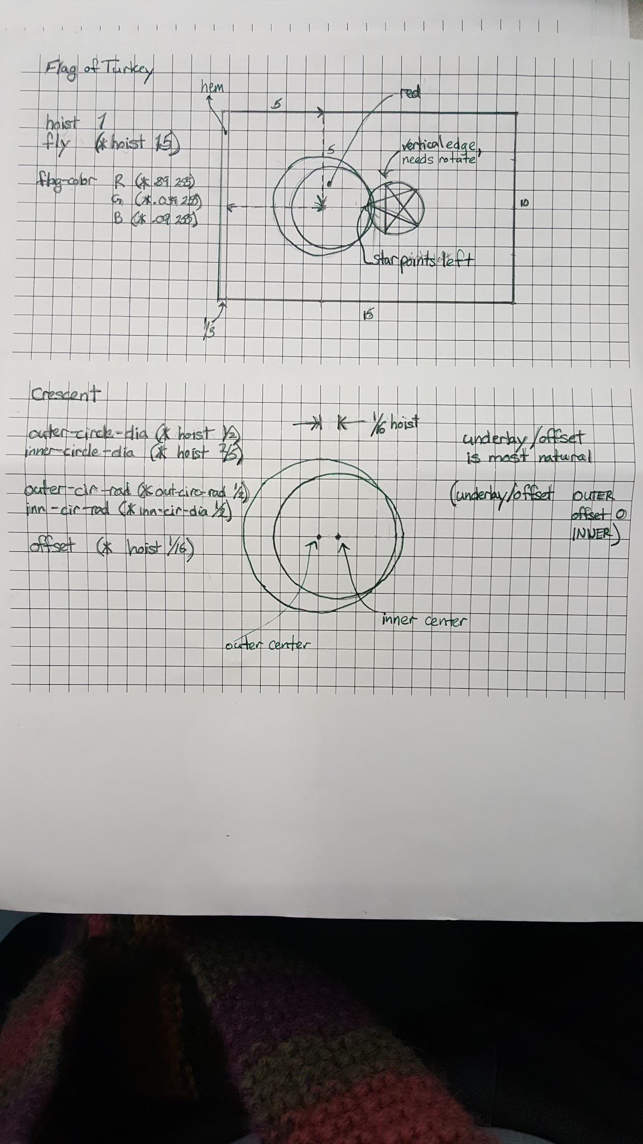

Slide 5
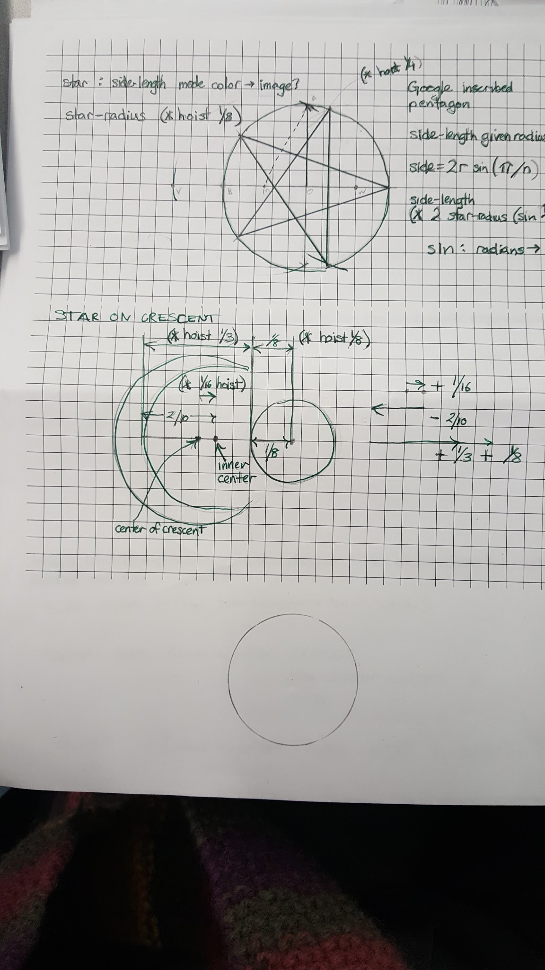

Slide 7
; make-color : Num Num Num (Num) -> color
(circle 50 “solid” “red”)
“is the same as”
(circle 50 “solid” (make-color 255 0 0))

Slide 8
Hex to Decimal
Old Glory Blue 0x3C3B6E
Old Glory Red 0xB22234

Slide 9
Hex to Decimal
Old Glory Blue 0x3C 3B 6E
3*16 + 12*1
60

Slide 10
Hex to Decimal
Old Glory Blue 0x3C 3B 6E
3*16 + 11*1
60 59

Slide 11
Hex to Decimal
Old Glory Blue 0x3C 3B 6E
6*16 + 14*1
60 59 110

